Slide 1
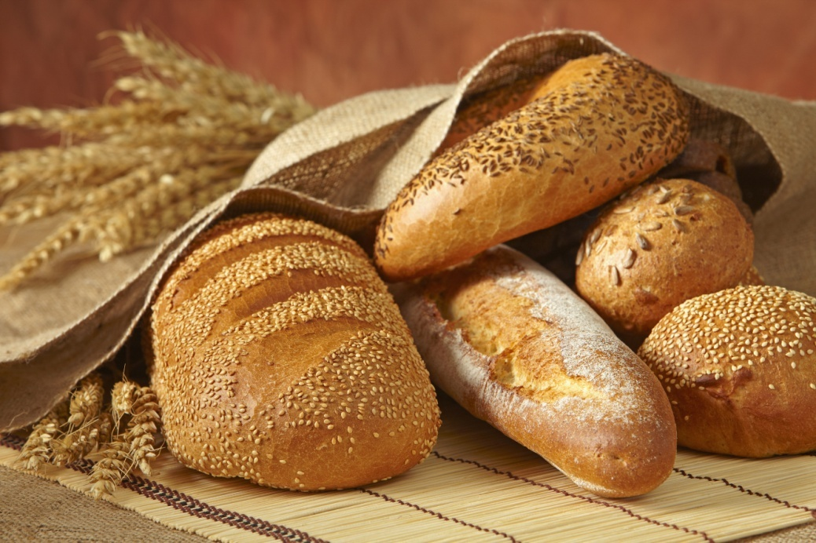
Bread & Related Bakery Products
Welcome to the Webinar
May 21, 2013

Slide 2
Welcome & Introductions
Andy Penick, GCPA, MBA
DOAS Contract Manager
Associate Category Manager
State Purchasing Division
Dr. Carl A. Hall, PhD, JD, MBA, C.P.M., CPPB, GCPA
Category Manager
State Purchasing Division
Steve Archer
Director of Retail Sales
Flowers Baking Co. of Villa Rica, LLC
Shivhan Daniels
Account Manager - Georgia
Earthgrains Baking Companies
cal
Notes:
2

Slide 3
Resources
State Procurement Help Desk:
(404) 657-6000
8:00 a.m. – 5:00 p.m.
procurementhelp@doas.ga.gov
Notes:
3

Slide 4
Go Live Start Date
The current contract SWC40537 ends May 31, 2013
The New contract SWC# 99999-SPD0000091 begins June 1, 2013.
Please do not attach PO’s to SWC40537 after June 1, 2013.
SWC 99999-SPD0000091
BEGINS
JUNE 1, 2013
SWC40537 ENDS
MAY 31, 2013

Slide 5
Announcement
The Georgia Department of Administrative Services, State Purchasing Division, is issuing information regarding new Mandatory Statewide Contracts (awarded by category) for:
Bread and Related Bakery Products,
SWC# 99999-SPD0000091-0001, with Flowers Baking Company, and SWC# 99999-SPD00000-0002 with Earthgrains Baking Companies.
The implementation date of this new contract is June 1, 2013.

Slide 6
Key Points & Benefits
Bread & Related Bakery Products
Mandatory Statewide Contract # SPD0000091
Effective Date of June 1, 2013
Awarded by six categories to two suppliers
Not divided into regions
Both Awarded Suppliers Deliver Statewide
Expanded Core Line Items List with forty six (46) products
New Non-Core Line Item List with ninety three (93) products
Ability to submit orders with the delivery person, or via email, phone, or fax methods
Make purchases using the State Purchasing Card (P-Card)
No minimum order requirements
Accepts PeopleSoft purchase orders as well as established entity PO forms
This contract is available as a resource for use by Municipalities, Counties, Public Schools, Cities, Townships, and other Political Subdivisions within the State of Georgia*.
*(Contract is not available to any private organization, company, or enterprise)

Slide 7
Six Categories Awarded to Two Suppliers
1. Flowers Baking Company | 2. Earthgrains Baking Co
Awarded Two Categories: | Awarded Four Categories:
“Day-Old” Bread, Sliced Sandwich Loaves | Fresh Baked Bread, Sliced Sandwich Loaves
Cakes, Snack Cakes, Honey Buns, Donuts, Sweet Rolls, Pies, and Pastries | Buns, Hamburger, Hot Dog, Hoagie, Steak, Sandwich Rounds, English Split Fork Muffins, Bagels, Croissants, Tortillas
 | Rolls, Sandwich Type, Sub, French, Sliced and Unsliced
 | Rolls, Dinner Type, Sheeted, Non-Sliced, including Brown ‘n Serve

Slide 8
Fast & Easy Ordering
  Ordering Instructions & Cost on TGM
  Easy to read cost sheets
  Order directly with your delivery route driver
  Email to the supplier’s order desk
  Fax to the supplier’s order desk
  Call supplier’s customer service
  Call the Supplier’s Contract Manager

Slide 9
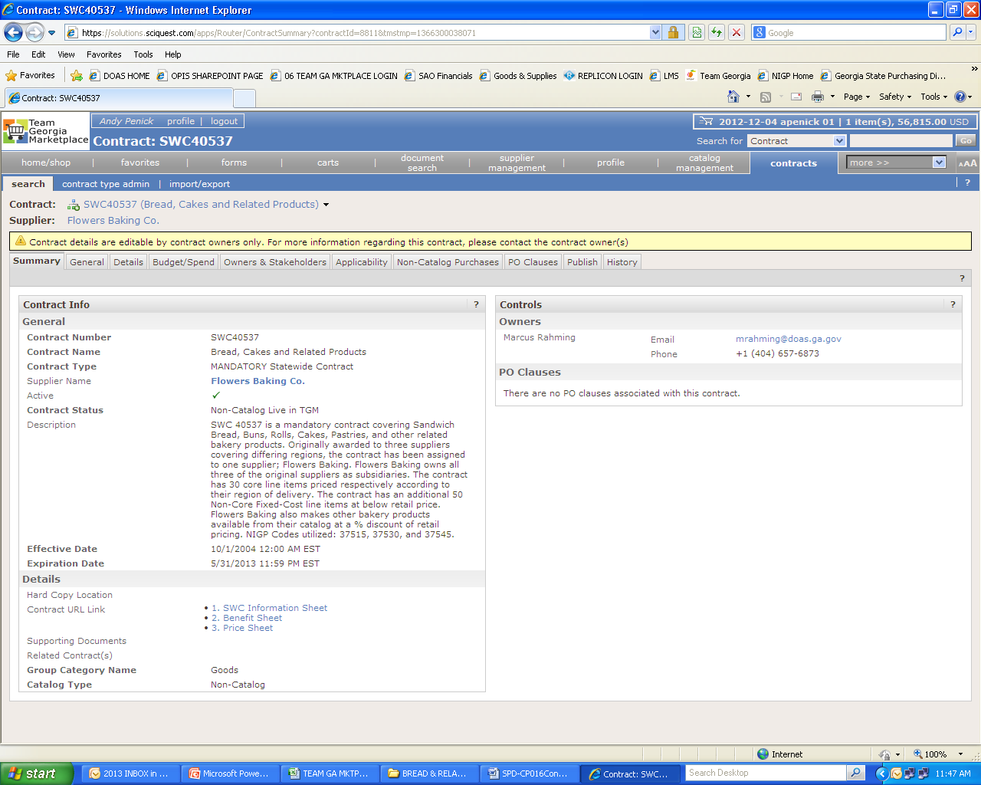
TeamGeorgia Marketplace Price File Location
Notes:
9

Slide 10
TeamGeorgia™ Ordering Instructions
TAB #1: Ordering Instructions/Supplier Contacts
  TAB #2: Core Line Items Cost Sheet
          Forty Six (46) Core Line Items
TAB #3: Non-Core Line Items Cost Sheet
        Ninety Three (93) Non-Core Line Items

Slide 11
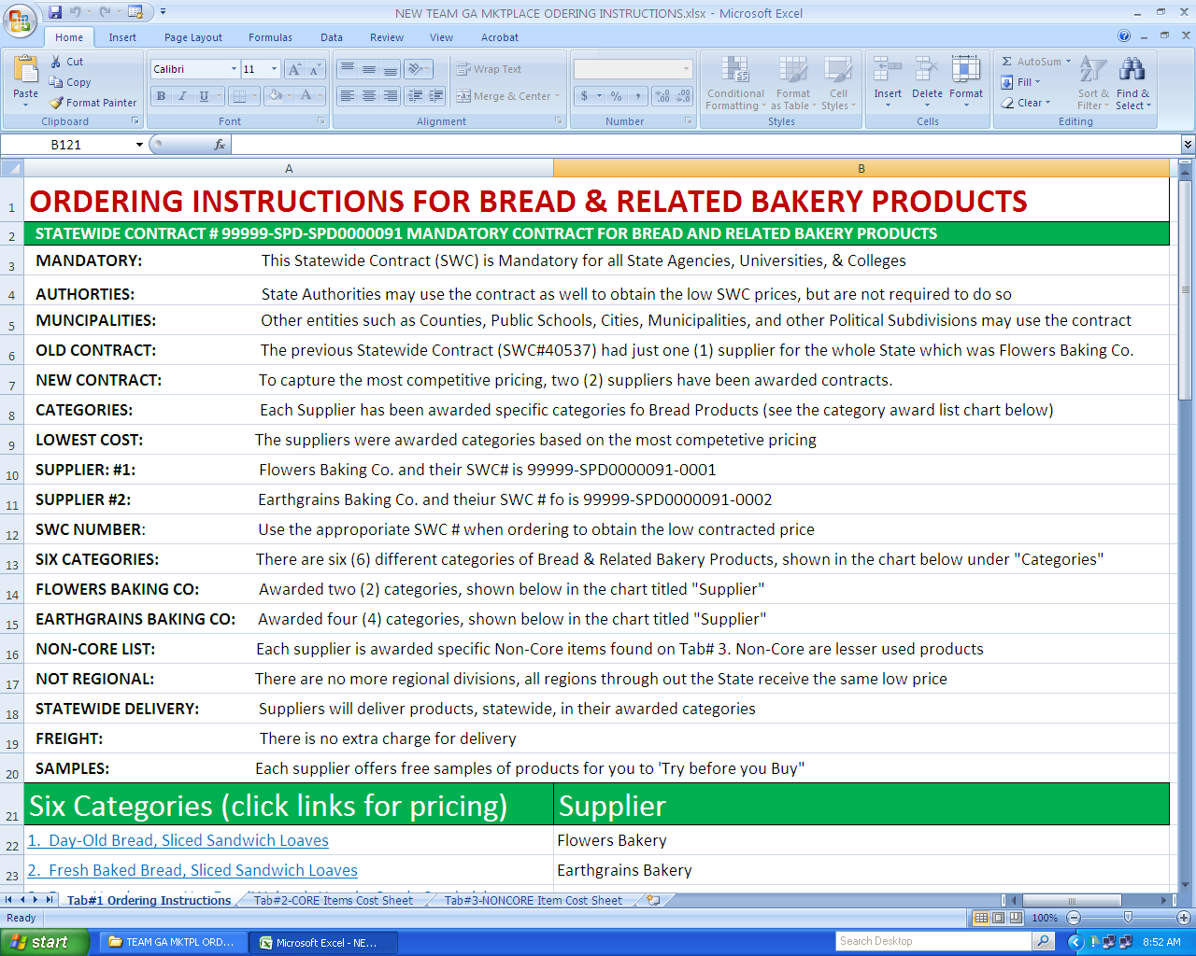
Tab #1: Ordering Instructions The Ordering Instructions Page in TGM

Slide 12
Contact info for the two awarded suppliers
To Order Flowers Baking Company Products
1. Place order directly with your delivery route person
2. Email order to Steve_Archer@flocorp.com
3. Fax order to (770) 459-1161
4. Call Steve Archer at (404) 275-8558
Flowers Baking Contract Manager
Steve Archer
Director of Retail Sales
Flowers Baking Company of Villa Rica, Inc.
Off Ph: (770) 459-2883 ext. 498
Mobile: (404) 275-8558
Bus Fax: (770) 459-1161
Steve_Archer@flocorp.com
134 Doyle McCain Drive
Villa Rica, GA 30180
Flowers Baking Customer Service
Steve Archer
Director of Retail Sales
Flowers Baking Company of Villa Rica, Inc.
Off Ph: (770) 459-2883 ext. 498
Mobile: (404) 275-8558
Bus Fax: (770) 459-1161
Steve_Archer@flocorp.com
Flowers Baking Remit to Address
Flowers Baking Company of Villa Rica, Inc.
P O BOX 751142
Charlotte, NC 28275
For Electronic Funds Transfer Payments to Flowers
N/A
Flowers Delivery Schedule-4 Days after PO is Received
Order Monday - Deliverly on Thursday/Friday
Order Tuesday - Deliverly on Friday
Order Thursday - Delivery on Monday
Order Friday - Delivery on Monday/Tuesday
Order Saturday - Delivery on Tuesday
All Cake products -Ordered 7 days in advance of your delivery day - Monday or Thursday.
All Non-Core Items (Tab#3) must be ordered 7 days in advance of your delivery day.
To Order Earthgrains Baking Companies Products
1. Place order directly with your District Manager (list below) or delivery person
2. Email order to Sdaniels@sl.bbumail.com
3. Fax order to (800) 233-4464
4. Call Customer Service at (800) 233-2253
Earthgrains Baking Contract Managers
Shivhan Daniels
Account Manager, Georgia
Earthgrains Baking Compaines, LLC (Owned by Bimbo Bakeries USA)
Off Ph: 404-244-4500 ext. 4482
Mobile: (404) 574-3967
Bus Fax: (800) 233-4464
SDaniels@sl.bbumail.com
3310 Pantersville Road
Decatur, GA 30034
Earthgrains Baking Customer Service
Angie Bell
Customer Service
Earthgrains Baking Compaines, LLC (Owned by Bimbo Bakeries USA)
Office Ph: (404) 244-4506
Abell@sl.bbumail.com
3310 Panthersville Rd
Decatur, GA 30034
Earthgrains Baking Remit to Address
Earthgrains Baking Companies, Inc.
PO Box 901018
Fort Worth, Texas 76101
accountspayable@mailbu.com
For Electronic Funds Transfer Payments to Earthgrains Baking
JP MORGAN CHASE N.A.
1 Chase Manhattan Plaza
New York, NY 10005-1401
Account Name: Earthgrains Baking Companies, Inc.
Account #: 1283673
ABA# / Routing #: 072000326
Delivery Schedule - Four Days after PO is Received
Order Monday - Deliverly on Friday
Order Tuesday - Deliverly on Saturday (Monday)
Order Thursday - Delivery on Monday
Order Friday - Delivery on Tuesday
Order Saturday - Delivery on Thursday

Slide 13
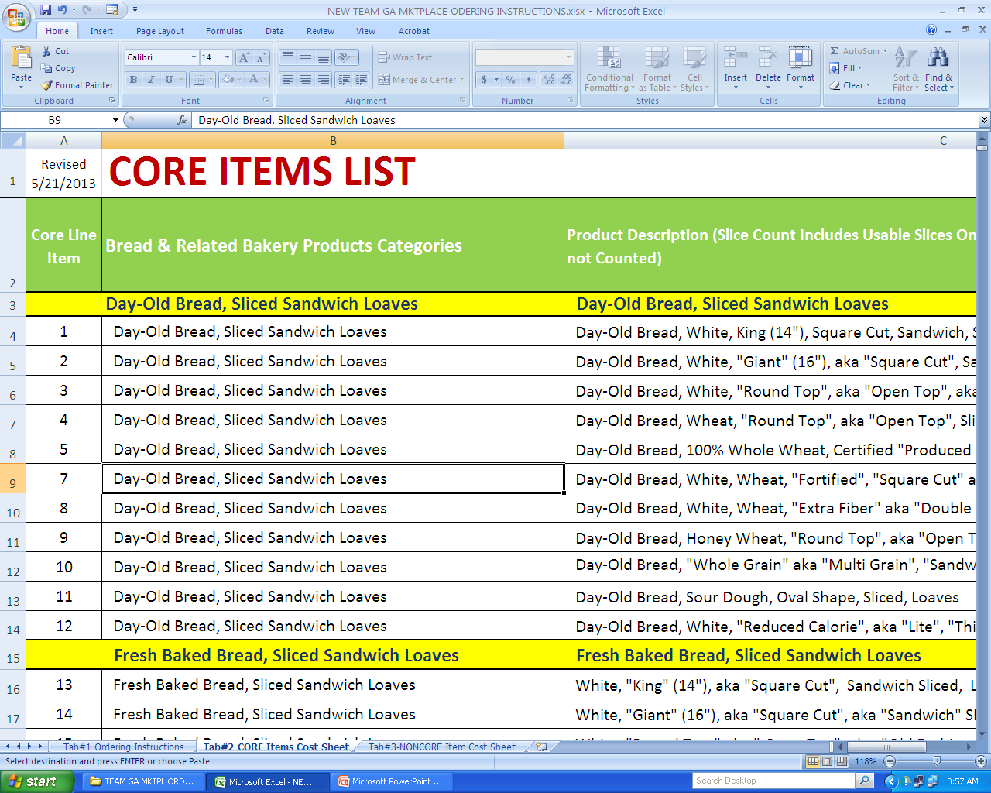
Tab #2: Core Item’s Cost Sheet
Notes:
13

Slide 14
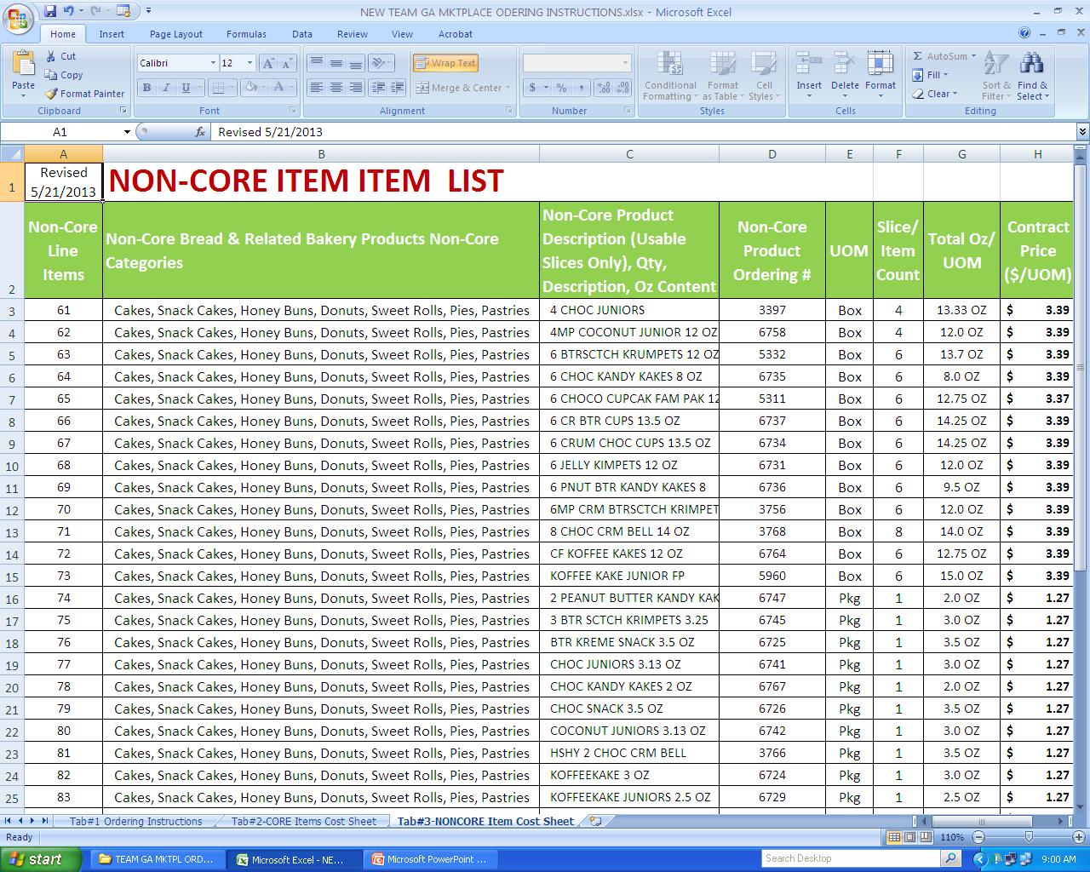
Tab #3 Non-Core Item’s Cost Sheet

Slide 15
Summary
Two Suppliers
Awarded by Categories, Not Regions
Both Suppliers Deliver Statewide
Easy Ordering Process
Go-Live Date is June 1, 2013
Categories | Supplier
1. Day-Old Bread, Sliced Sandwich Loaves | Flowers Bakery
2. Fresh Baked Bread, Sliced Sandwich Loaves | Earthgrains Bakery
3. Buns, Hamburger, Hot Dog (Weiner), Hoagie, Steak, Sandwich Rounds, English Split Fork Muffins, Bagels, Croissants, Tortillas | Earthgrains Bakery
4. Rolls, Sandwich Type, Sub, Cuban, French, Sliced and Unsliced | Earthgrains Bakery
5. Rolls, Dinner Type, Sheeted, Non-Sliced, including Brown 'n Serve | Earthgrains Bakery
6. Cakes, Snack Cakes, Honey Buns, Donuts, Sweet Rolls, Pies, and Pastries | Flowers Bakery

Slide 16
DOAS Contact Information
Andy Penick, GCPA, MBA
Associate Category Manager
DOAS State Purchasing Division
Phone: (404) 656-0379
Fax: (770) 344-5196
andy.penick@doas.ga.gov
www.doas.ga.gov
200 Piedmont Avenue S.E.
Suite 1308, West Tower
Atlanta, Georgia 30334-9010
Supplier’s Contact Information
Steve Archer
Director Retail Sales
Flowers Baking Co. of Villa Rica
Cell Ph: (404) 275-8558
Office: (770) 459-2883 ext 498
Fax: (770) 459-1161
After 5:30pm: (800) 822-4634
134 Doyle McCain Drive
Villa Rica, GA 30180
Shivhan Daniels
Earthgrains Baking Companies, Inc.
Account Manager, Georgia
Cell Ph: (404) 574-3967
Fax: (404) 244-4464
Email: SDaniels@sl.bbumail.com
3310 Panthersville Rd
Decatur, GA 30034
Angie Bell
Earthgrains Baking Companies, Inc.
Office Ph: (404) 244-4506
Fax: (404) 244-4464
Email: Abell@sl.bbumail.com
3310 Panthersville Rd
Decatur, GA 30034

Slide 17
Questions & Answers
Notes:
17

